Slide 1


The Global Project
on Measuring the Progress of Societies
Adolfo Morrone
ilerleme
التقدم
progress
進歩
vooruitgang
progresso
fremskridt
framsteg
progrès
haladás
进展
progreso
진보

Slide 2
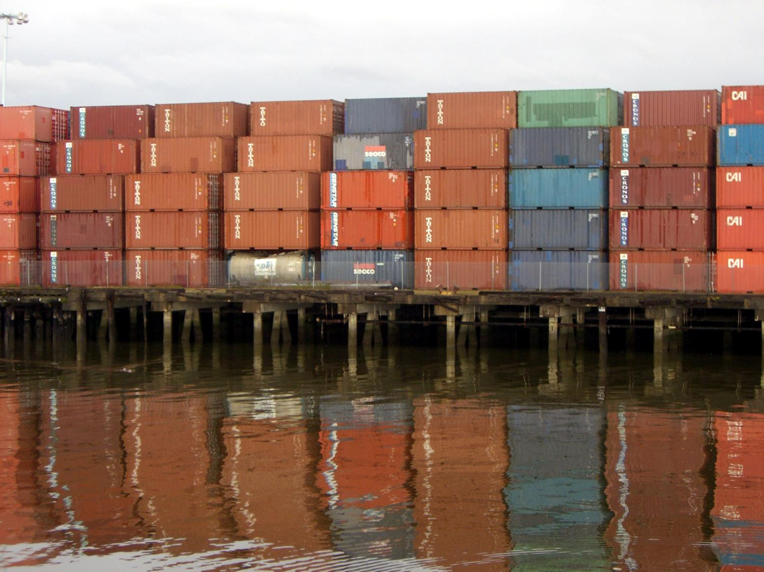
GDP is an important economic indicator that measures output.
Notes:
http://www.flickr.com/photos/telstar/128486232/sizes/o/

Slide 3
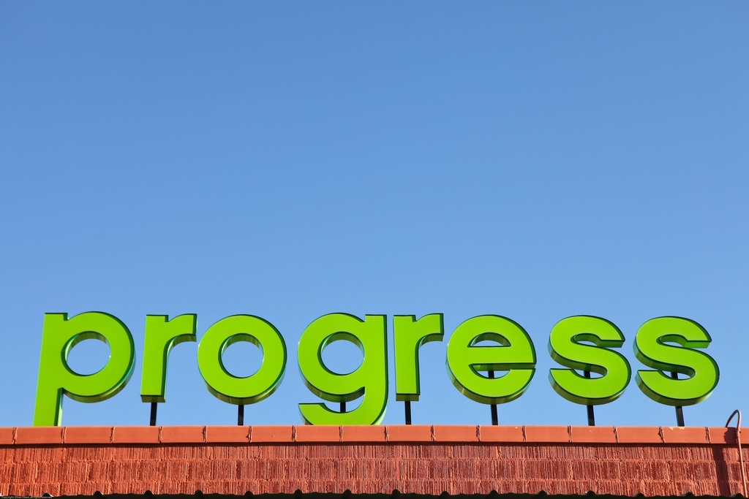
But it doesn’t give a full picture of social progress and well-being
But it is not sufficient to measure
Notes:
For many years Gross Domestic Product has been the dominant way in which progress has been measured. GDP captures important aspects of progress (material well-being) but:
it fails to capture the multidimensionality of well-being and several aspects of life that people value;
even the evolution of material well-being and living standards of the ‘typical’ citizen is often badly captured by the change in GDP per capita.

Slide 4
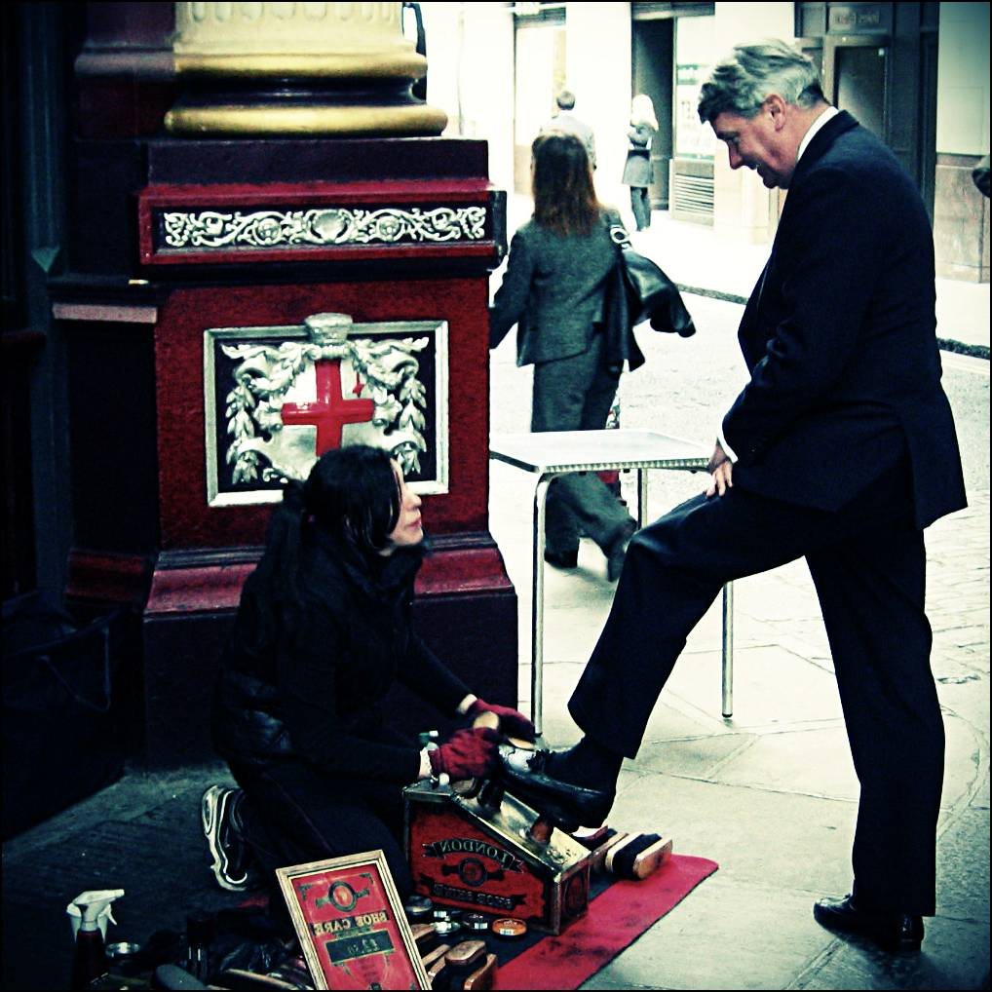
GDP per capita is just GDP divided by the size of the population. It doesn’t tell us what people are actually earning or if that’s rising.
Notes:
http://www.flickr.com/photos/_sid_/1288628937/sizes/o/

Slide 5
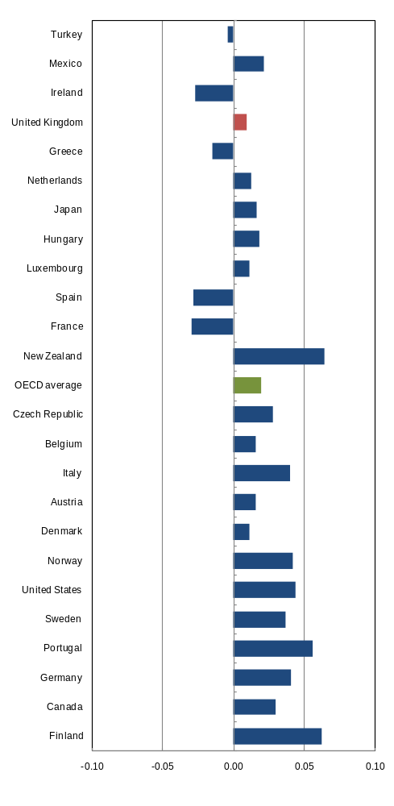
Growing inequalities
Trends in income inequality
Cumulative points change in the Gini coefficient - Mid-1980s to Mid-2000s
Source: OECD, Factbook 2009
Notes:
There is considerable variation in income inequality across OECD countries. Inequality as measured by the Gini coefficient is lowest in Denmark and Sweden and highest in Mexico and Turkey. It is above-average in Poland, Portugal and the United States, and below-average in the remaining Nordic and many Continental European countries. The Gini coefficient for the most unequal country (Mexico) is double the value of the most equal country (Denmark). Overall, the different measures of income inequalities provide similar ranking across countries.
From the mid-1980s to the mid-2000s, inequality rose in 19 out of 24 countries. The increase was strongest in Finland, New Zealand and Portugal. Declines occurred in France, Greece, and Turkey, as well as Ireland and Spain (where trend data are limited to 2000). Income inequality generally rose faster from the mid-1980s to the mid-1990s than in the following decade.

Slide 6
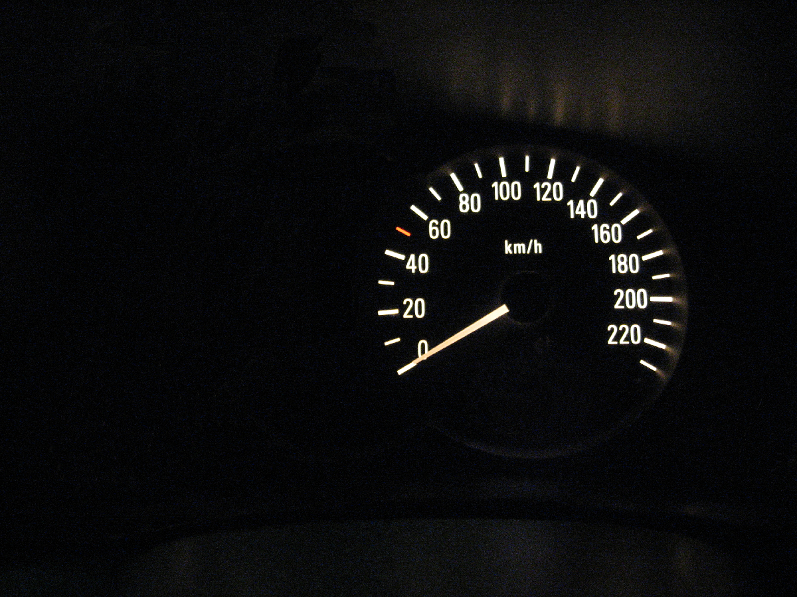
Relying on GDP alone would be like driving a car only looking at the speedometer…
Notes:
http://www.flickr.com/photos/g_kat26/3614041318/sizes/o/

Slide 7
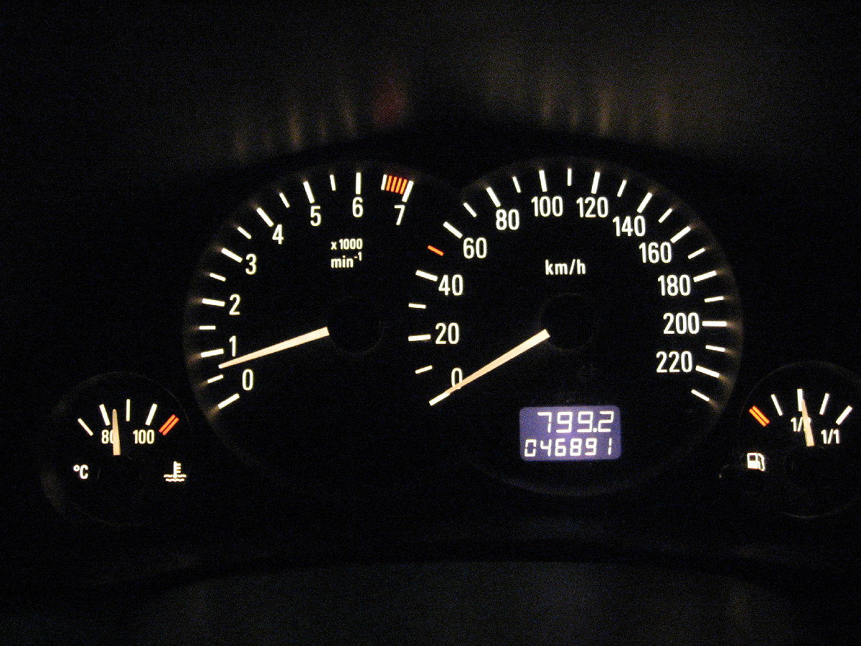
Relying on GDP alone would be like driving a car only looking at the speedometer…
But other indicators are necesary to assess the success of a policy.
Notes:
http://www.flickr.com/photos/g_kat26/3614041318/sizes/o/

Slide 8
A growing movement
National initiatives: Australia, US, Ireland, South Africa, Niger, Finland, Hungary, Italy, Canada, Netherlands, Morocco, etc.
Local initiatives:
  US: Community Indicators Consortium
  EU: Council of Europe
  UK:Young Foundation
  France: FAIR
  Italy: Sbilanciamoci
  Latin America: Como Vamos
International Association of Supreme Auditors
Oxford Poverty and Human Development Initiative
International Society for Quality of Life Studies
World Women Forum
Notes:
The number of initiatives launched around the world to measure progress/well-being/sustainable development of countries and local communities is simply amazing. Since the number of initiatives, launched around the world, to measure progress/well-being/sustainable development of countries and local communities is increasingly growing, the Global Project can also serve as a place where initiatives network to share their expertise.

Slide 9
Commission on “Measurement of economic performance and social progress”
Breadth of measurement challenges well defined by Stiglitz/Sen Commission
Report delivered on Sep 14
  Classical GDP issues
  Quality of life
  Sustainability
The OECD will follow up in several domains.
  It is important to brings out the multi-dimensional character of what citizens consider essential for their well-being
Notes:
Progress has become a hot topic in the political world. President Obama’s Presidential campaign was based on the theme of progress. The European Commission just released a Communication to Member Countries on “GDP and Beyond”. The World Economic Forum established the Global Council on “Benchmarking the progress in societies”.
The most prominent example of these initiatives is the establishment, by the President of the French Republic of a Commission on the Measurement of Economic Performance and Social Progress.
Its aims are to identify the limits of Gross Domestic Product (GDP) as an indicator of economic performance and social progress; to consider additional information required for the production of more relevant indicators; to discuss how to present this information in an appropriate way; and to assess the feasibility of alternative measurement tools.
More generally, the work of the CMEPSP brings out the multi-dimensional character of what citizens consider essential for their well-being. Only by tracking all the key dimensions of people’s well-being – above and beyond material living standards – will it be possible to understand and design policies aimed at accommodating tensions in society, including those that have accompanied the financial, economic and social crises.

Slide 10
Why a Global Project ?
The Global Project is the first systematic global effort to go “beyond GDP” by enabling and promoting new ways to measure societal progress
The Global Project aims to foster the development of sets of key economic, social and environmental indicators to provide a comprehensive picture of how the well-being of a society is evolving and seeks to encourage each society to consider in an informed way the crucial question: is life getting better?
Brings together the large and growing movement that seeks to understand and measure progress.

Slide 11

Progress indicators as structural DNA codes
“Statistical indicators are the structural DNA codes of nations. They reflect a society’s values and goals and become the key drivers of economic and technological choices”
Hazel Henderson

Slide 12
The Global Project Philosophy
How to Measure?
Selecting indicators of progress is (mainly) a technical issue
We are developing best practices
What to Measure?
Defining what progress looks like is a political issue. We can advise on how to set up a process that is legitimate and reflects the share values of a society. But the choice belongs to the society.

Slide 13
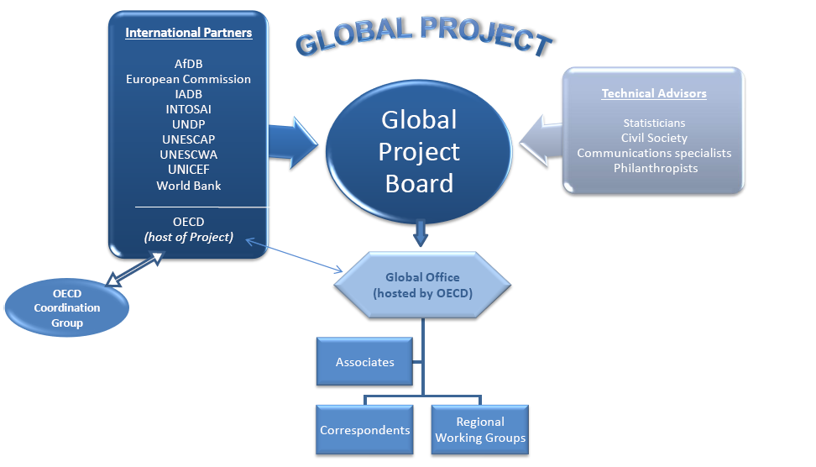
The GP as a network of networks
Notes:
The GP is structured as a “network of networks”, in other words as a co-operation among organisations based in all regions of the world, with different focuses, scopes and mandates. The activities of the GP are carried out by groups of interested organisations which include: international organisations, national public and private organisations, foundations, universities and research centres. These organisations provide financial and in-kind contributions to achieve the GP’s goals.
Associate Partners are public and private national and international organisations that are interested in contributing to specific activities
Correspondents are organisations wishing to support work on measuring the progress of society in their country/region.
Sponsors are organisations which provide financial or in-kind resources

Slide 14
Establishment and co-ordination of Regional Working Groups
OECD countries: The Co-ordination Group represents the body for OECD countries and non-member economies who are observers in the Committee on Statistics.
Arab countries: ESCWA is our regional partner. A Steering Committee for measuring progress in the Arab region has been recently set up.
Latin America: The OECD is working with the Inter American Development Bank to establish a regional group in Latin America
Africa: The ADB is the partner in the region. The precise objectives of the collaboration are still under discussion.
Asia and Pacific: UNESCAP welcomed the Project and asked the Secretariat to take it forward.
Notes:
The establishment and co-ordination of regional working groups is an important tool to make the Project truly global and influential. The groups are supposed to provide an opportunity for those interested in measuring the progress of their societies to discuss issues with their peers within their region.

Slide 15










Organisation of Meetings/Workshops
Meetings play a role in laying the groundwork for the biennial World Forums and provide an opportunity to bring people together so that they, and the GP, can better understand what work is underway in their region and to communicate their priorities for action and findings to the rest of the world.
Notes:
The communication dimension is key to any initiative, but especially for a Project that wants to become the catalyst of existing networks of researchers and practitioners, as well as to influence culture worldwide.

Slide 16
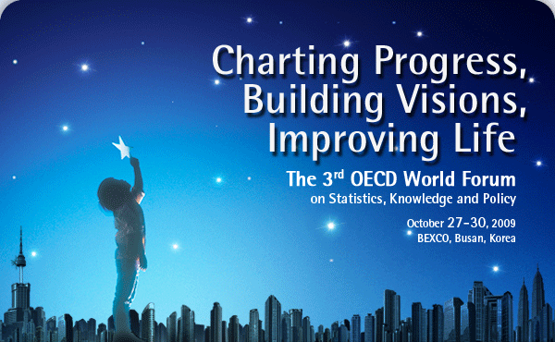
The 3rd OECD World forum
Under the theme of "Charting Progress, Building Visions, Improving Life," the 3rd OECD World Forum has been an opportunity to re-identify what progress means in the 21st century. Also, it contributes to share the best practices of evidence-based policy making.

Slide 17
Training courses
The GP training program began in 2008 and met great success and enthusiasm. The aim of the training programme is to provide assistance to those wanting to measure progress, raise awareness and teach new methods, concepts and tools.
2010 and 2011 should see a significant expansion of this training work, thanks also to the development of E-learning courses with UNITAR

Slide 18
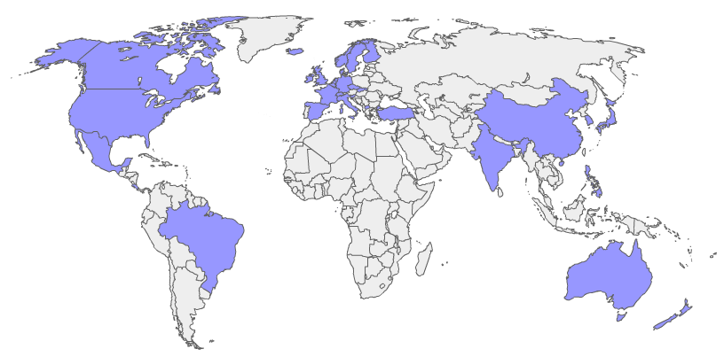
Knowledge Base on Initiatives to Measure Progress
http://www.measuringprogress.org/knowledgeBase/
Notes:
It describes initiatives around the world on measures of progress (or sustainability, well-being or quality of life) and demonstrates the growing interest in these new measures.

Slide 19
Wiki-progress
A global platform to serve all people in the world to understand and debate, using statistical indicators, whether the world itself, or a particular country or region, is making progress.
Wiki-progress will:
  bring data and metadata in the same environment to build a single, integrated database;
  allow a simple use of statistical data to create charts and tables to be posted on various platforms (Wikipedia, etc.)
Notes:
The main attribute of a Wiki is that authors contribute their knowledge to a single repository, designed to represent the synthesis of what the “collective intelligence” is able to build about that particular subject

Slide 20
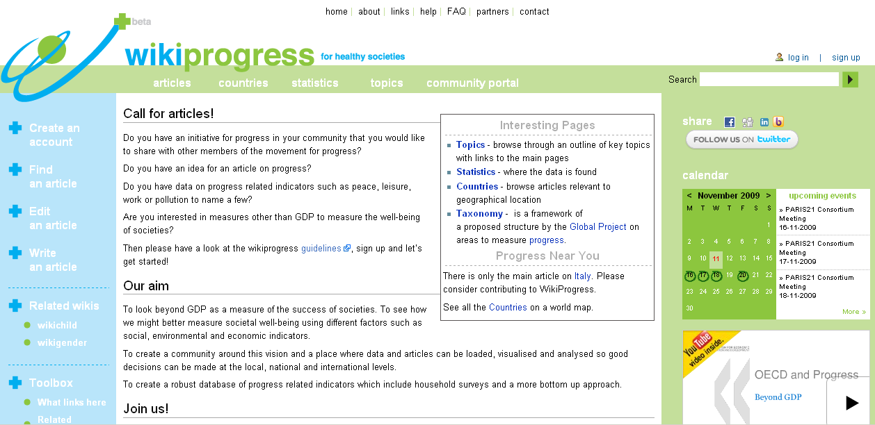
www.wikiprogress.org
Notes:
Wiki-progress will represent the catalyst of initiatives existing around the world on the measurement of progress, contributing to answer the following questions:
Who is developing initiatives on measuring progress (well-being, quality of life, etc.);
What type of taxonomy do these initiatives use?
Which indicators are being used to measure the different dimensions of progress?
How is my country/region/community achieving over time and in comparison to other similar territories?
The main attribute of a Wiki is that authors contribute their knowledge to a single repository, designed to represent the synthesis of what the “collective intelligence” is able to build about that particular subject

Slide 21
The benefits
for citizens
for policy makers
for countries

Slide 22
The benefits for Citizens
Promote accountability and enhance citizen engagement.
Improve citizens knowledge giving them the opportunity to improve their decision making and to become more aware of the risks and challenges of today’s world

Slide 23
The benefits for Policy Makers
Policy makers can better assess the current situation, make more informed decisions, and measure progress over time and relative to other nations
Better coordination in government
Data to advocate necessary reforms and evaluate their impact on societal welfare

Slide 24
The benefits for Societies
By highlighting the issues that genuinely matter to a society, a set of progress measures can help a country best meet the needs of its citizens by focusing attention on the key outcomes
‘….transparency has the ability to reduce waste, prevent corruption, and shift resources where they’re truly needed

Slide 25
Progress Measures can help to:
Promote greater accountability
Enhance the quality of public debate
Help communities prioritize resource allocation

Slide 26
Progress Measures can help to:
Enhance democracy…
… enhance decision making…
… and so generate progress

Slide 27
Thank you for your attention
adolfo.morrone@oecd.org

